Slide 1
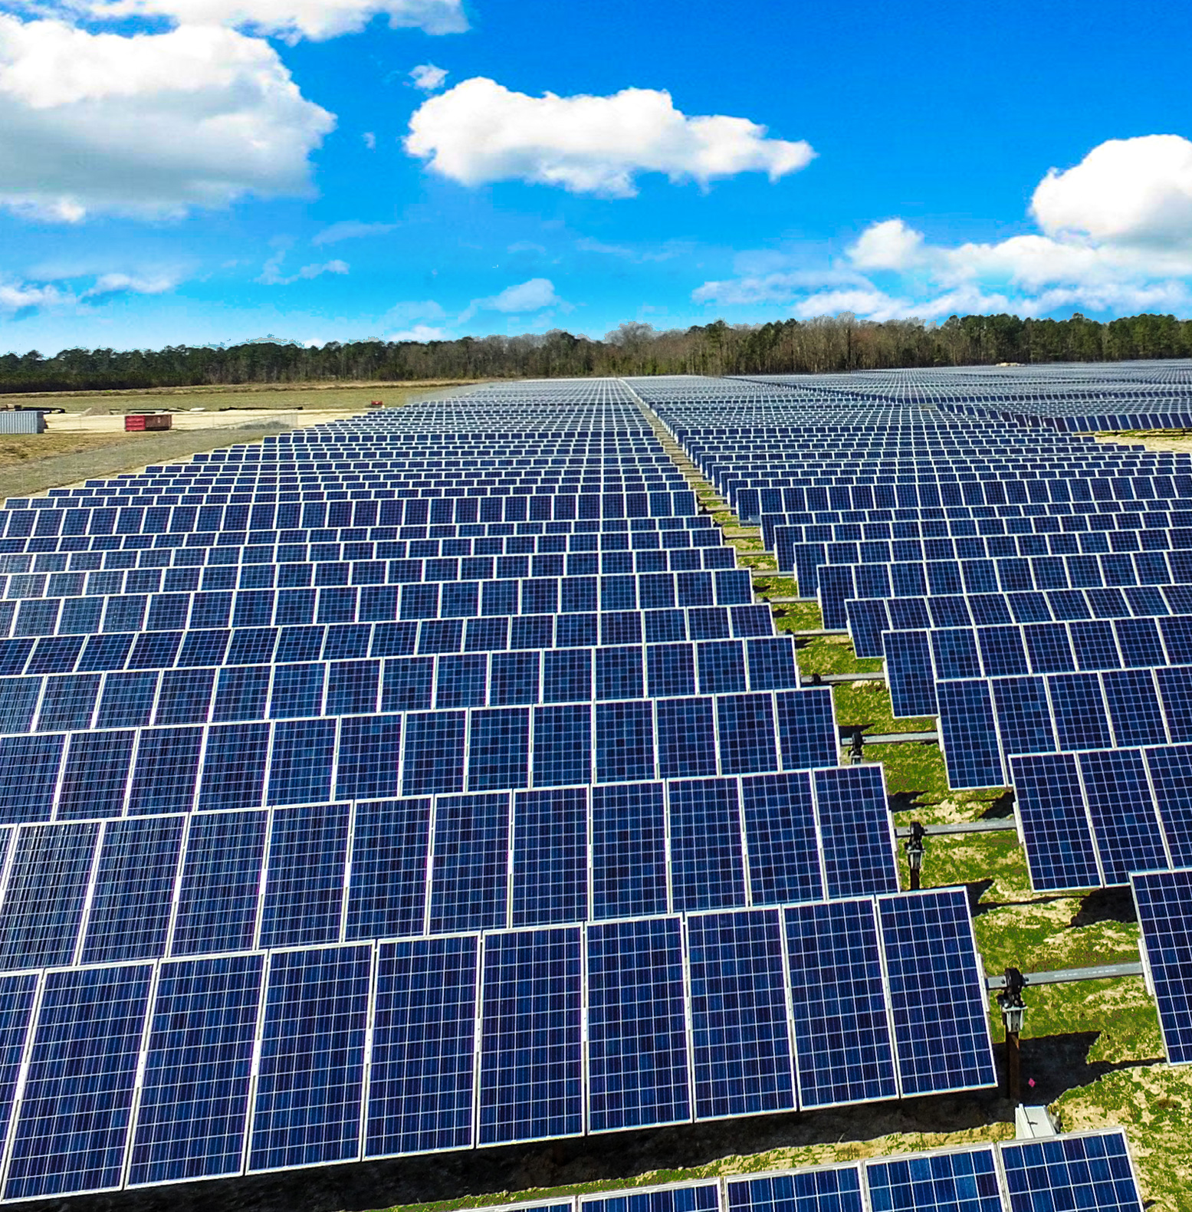
Renewable Resources – Page 1
Think about a world entirely powered by energy that never runs out, an appealing prospect, isn't it? This is the beautiful concept of renewable energy, akin to an infinite battery that keeps charging itself without any external input. Renewable energy sources, such as wind, solar, and hydroelectric power, are continuously replenished by natural processes, making them a sustainable choice for the future. By harnessing these unending sources of energy, we have the opportunity to significantly reduce our reliance on finite and environmentally damaging sources like fossil fuels, leading to a cleaner and more sustainable world.
What is the concept of renewable energy? ___________________________________________________________________
Name three examples of renewable energy. ___________________________________________________________________
What makes renewable energy a sustainable choice? ___________________________________________________________________
Consider solar power, a type of renewable energy that harnesses the massive energy radiated by our sun. Imagine the sun as a gigantic, powerful light bulb in the sky, pouring out a steady stream of energy towards Earth every day. Solar panels, with their specialized cells, act as sponges soaking up this energy and converting it into electricity. This conversion process is clean, producing no harmful pollutants or greenhouse gases. In regions blessed with abundant sunlight, solar power is an incredibly significant source of renewable energy, bringing light to homes and powering industries.
What is solar power? ___________________________________________________________________
How is the sun depicted in the paragraph? ___________________________________________________________________
Why is solar power considered to be clean? ___________________________________________________________________

Slide 2
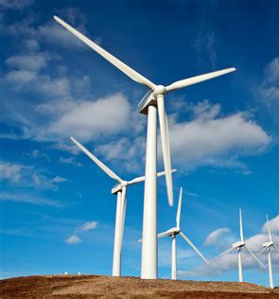
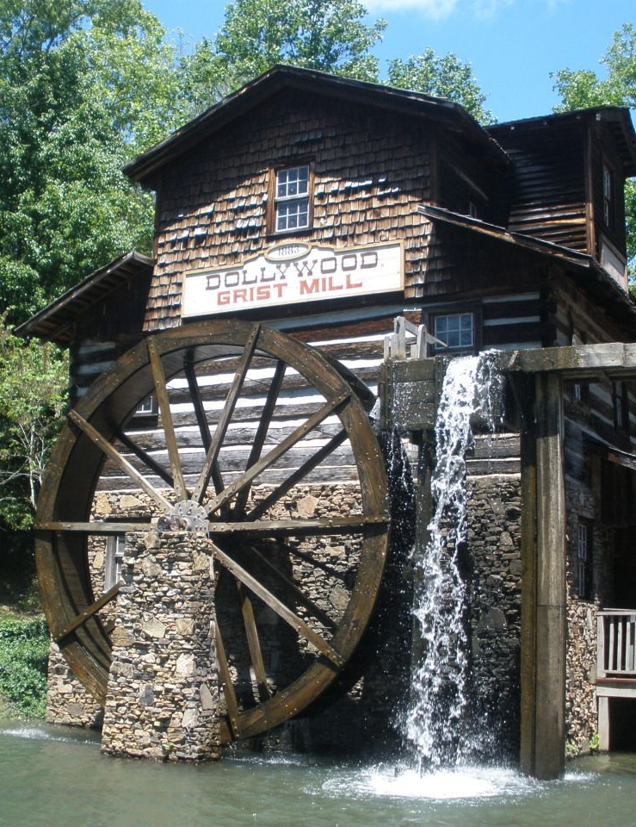
Renewable Resources – Page 2
Let's take a look at wind power, another fascinating form of renewable energy. Envision a powerful, giant fan that, instead of blowing air, produces electricity when it catches the wind. These are what wind turbines are—tall structures with large blades, rotating with the wind to generate power. As the wind blows, it pushes against the blades, making them rotate and generate electricity. Wind power is particularly effective in areas with open spaces and consistent, strong winds, turning them into powerhouses of renewable energy.
What energy source does wind power utilise? __________________________________________________________________
What is the function of a wind turbine? __________________________________________________________________
Where is wind power most effective? __________________________________________________________________
Lastly, let's dive into hydroelectric power, another renewable energy source that uses the force of water to generate electricity. Think of a massive water wheel steadily turning due to the force of a rushing river, but instead of grinding grain like in the olden days, it's now generating power. Modern versions of these water wheels are found in dams, structures that control the flow of water to generate electricity. Hydroelectric power is highly efficient and can produce a large amount of power, but careful management is needed to avoid disruption of local ecosystems.
What is hydroelectric power? __________________________________________________________________
What big object is used for hydroelectric power? __________________________________________________________________
Why is hydroelectric power considered efficient? __________________________________________________________________

